Slide 1

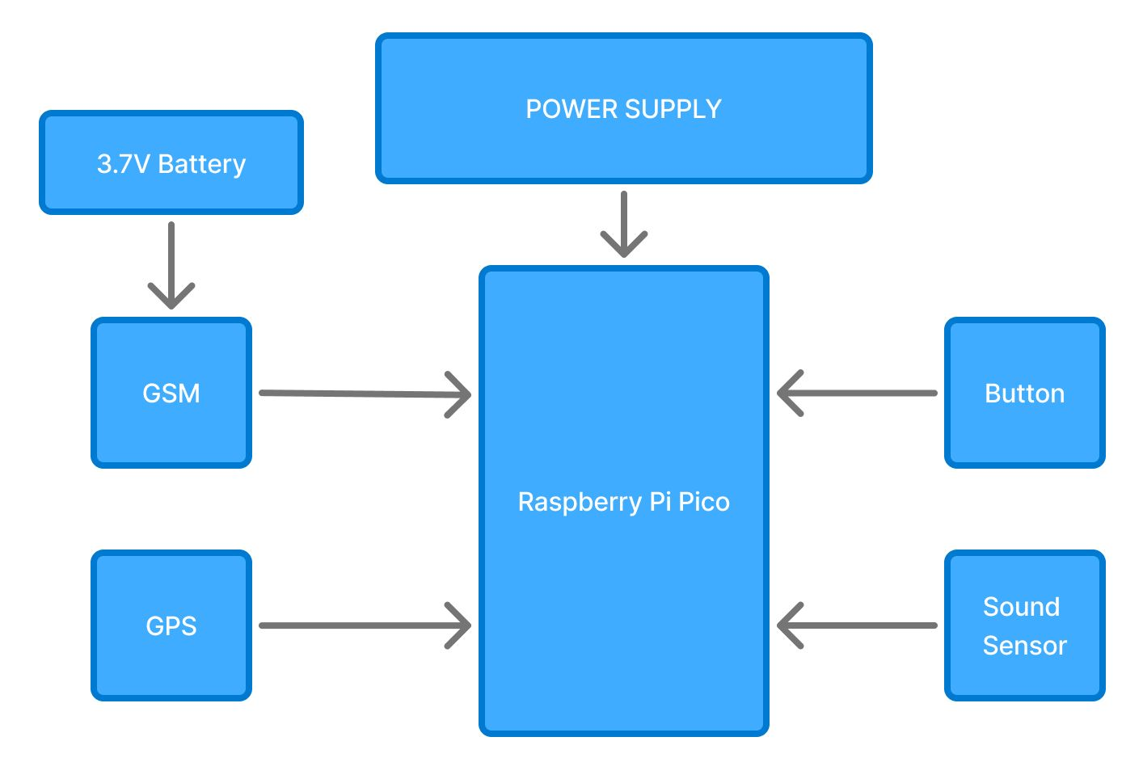
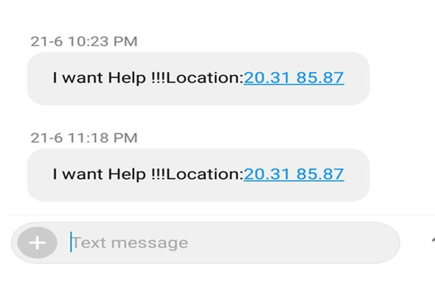
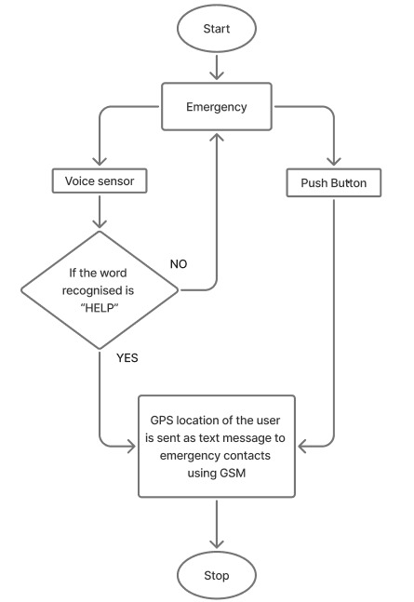
Department of Electronics and Telecommunication Engineering
ICC Mini Project Examination AY 2024-25 (Even Sem)
SafeHer: IoT Innovations for Women’s Safety
Student Names: Heer Upadhyay(25),Anshita Vasani(26),Jiya Waghela(28)
Abstract
Block diagram
Results
Women's safety has become a serious concern in today's society since they are afraid to leave their homes at any moment for fear of physical abuse and violence. Wearable technology is gaining popularity, being employed in a variety of applications, and wearable safety devices have found high demand in the market as of late. Our topic presents a device designed to enhance personal security by incorporating a GPS module that tracks the user’s location. It also presents an IoT-based system that helps women in distress by detecting danger and sending alerts to authorities and family members.
Introduction
The purpose of this device is to act as an emergency device for women who are in potential danger of being attacked. The Women possessing this device will press the panic button if in danger. An SMS containing the latitude and longitude coordinates will be sent to mobile numbers informing them about the danger and the location. The received coordinates can be viewed on Google maps to determine the location of the women and appropriate help can be provided. For sending the message to relevant controlling authority, GSM technology can be used. The Internet of Things (IoT) is the administration of physical articles by devices that include gadgets embedded within their engineering in order to interact and detect partnership with each other or with regard to the external world. The Internet of Things (IoT) is a new paradigm that allows electrical gadgets and sensors to communicate with one another via the internet in order to improve our lives.
Conclusions
The demo unit creates and the indicated "SafeHer: IoT Innovations for Women's Safety" is successfully experimented. The module targets providing women with total safety in risky situations. This project showcases major problems faced by women and resolves them. The device of women's safety based on IoT provides an innovative, cost-effective, and reliable solution for individual security challenges. Through GPS location, real-time alarm, and voice-video surveillance, the system assures individuals to be thoroughly protected under crisis situations and assistance can be dispatched in no time. It is also a low power demanding system with mobility to make its deployment on a day-to-day basis feasible. Moreover, due to its scalability, it allows for future capacity extension to implement enhanced safety capabilities. Effective production and deployment of this gadget brought to focus the central role IoT can play to enhance security.
flowchart
System components
Raspberry Pi Pico
GPS Module
GSM Module
Sound sensor
Push buttons
Jumper wires
Working principle
references
[1] Somashekar, H., B. Santhoshi, and T. Swetha. "ENHANCING WOMEN'S SAFETY WITH RASPBERRY PI PICO." Journal of Nonlinear Analysis and Optimization 14.2 (2023).
[2] Panda, Prabhat Kumar, et al. "A compact safety system for women security using IoT." 2020 IEEE international conference on technology, engineering, management for societal impact using marketing, entrepreneurship and talent (TEMSMET). IEEE, 2020.
[3] Saranya, N., et al. "A Smart friendly IoT device for women safety with GSM and GPS location tracking." 2021 5th International Conference on Electronics, Communication and Aerospace Technology (ICECA). IEEE, 2021.
[4] Roy, Pritika, Kazi Rifah Noor, and Sarowar Morshed Shawon. "Safe-Women: an IoT-Enabled Smart Safeguarding Device for Enhancing Women's Security." 2024 IEEE International Conference on Power (PEEIACON). IEEE, 2024.
In first when women in danger she can press a button then the SMS will send to the concerned contact number with the current location.
In second the existing device is redone to become familiar with the individual example of temperature, Heart Rate of the human body then find out the threshold. When these both are in the above threshold value then it automatically sends a message to concerned authorities
In the third condition when women are in danger and she is unable to press the button in that situation we use sound module (for example the women is used to say HELP) then the message will send to the concerned number with location which is one of the major advantages of this project.

